Slide 1
ET DOCKET NO. 16-191
FCC OFFICE OF ENGINEERNG AND TECHNOLOGY TECHNOLOGICAL ADVISORY COUNCIL NOISE FLOOR TECHNICAL INQUIRY(TI)
SUMMARY OF THE RESPONSES TO THIS TI
AND WHERE DO WE GO FROM HERE
Presented to ieee bts 2016 by
Tom f. king
President
Kintronic labs inc.

Slide 2
WHO CAN BENEFIT FROM A NOISE FLOOR STUDY?
Licensed and unlicensed users of electromagnetic spectrum among which are included:
  Analog and HD AM and FM radio listeners
  DTV viewers
  Cellphone users
  Amateur radio operators
  Broadband internet users

Slide 3
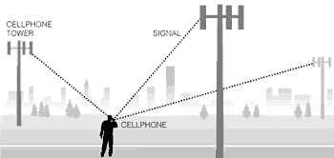
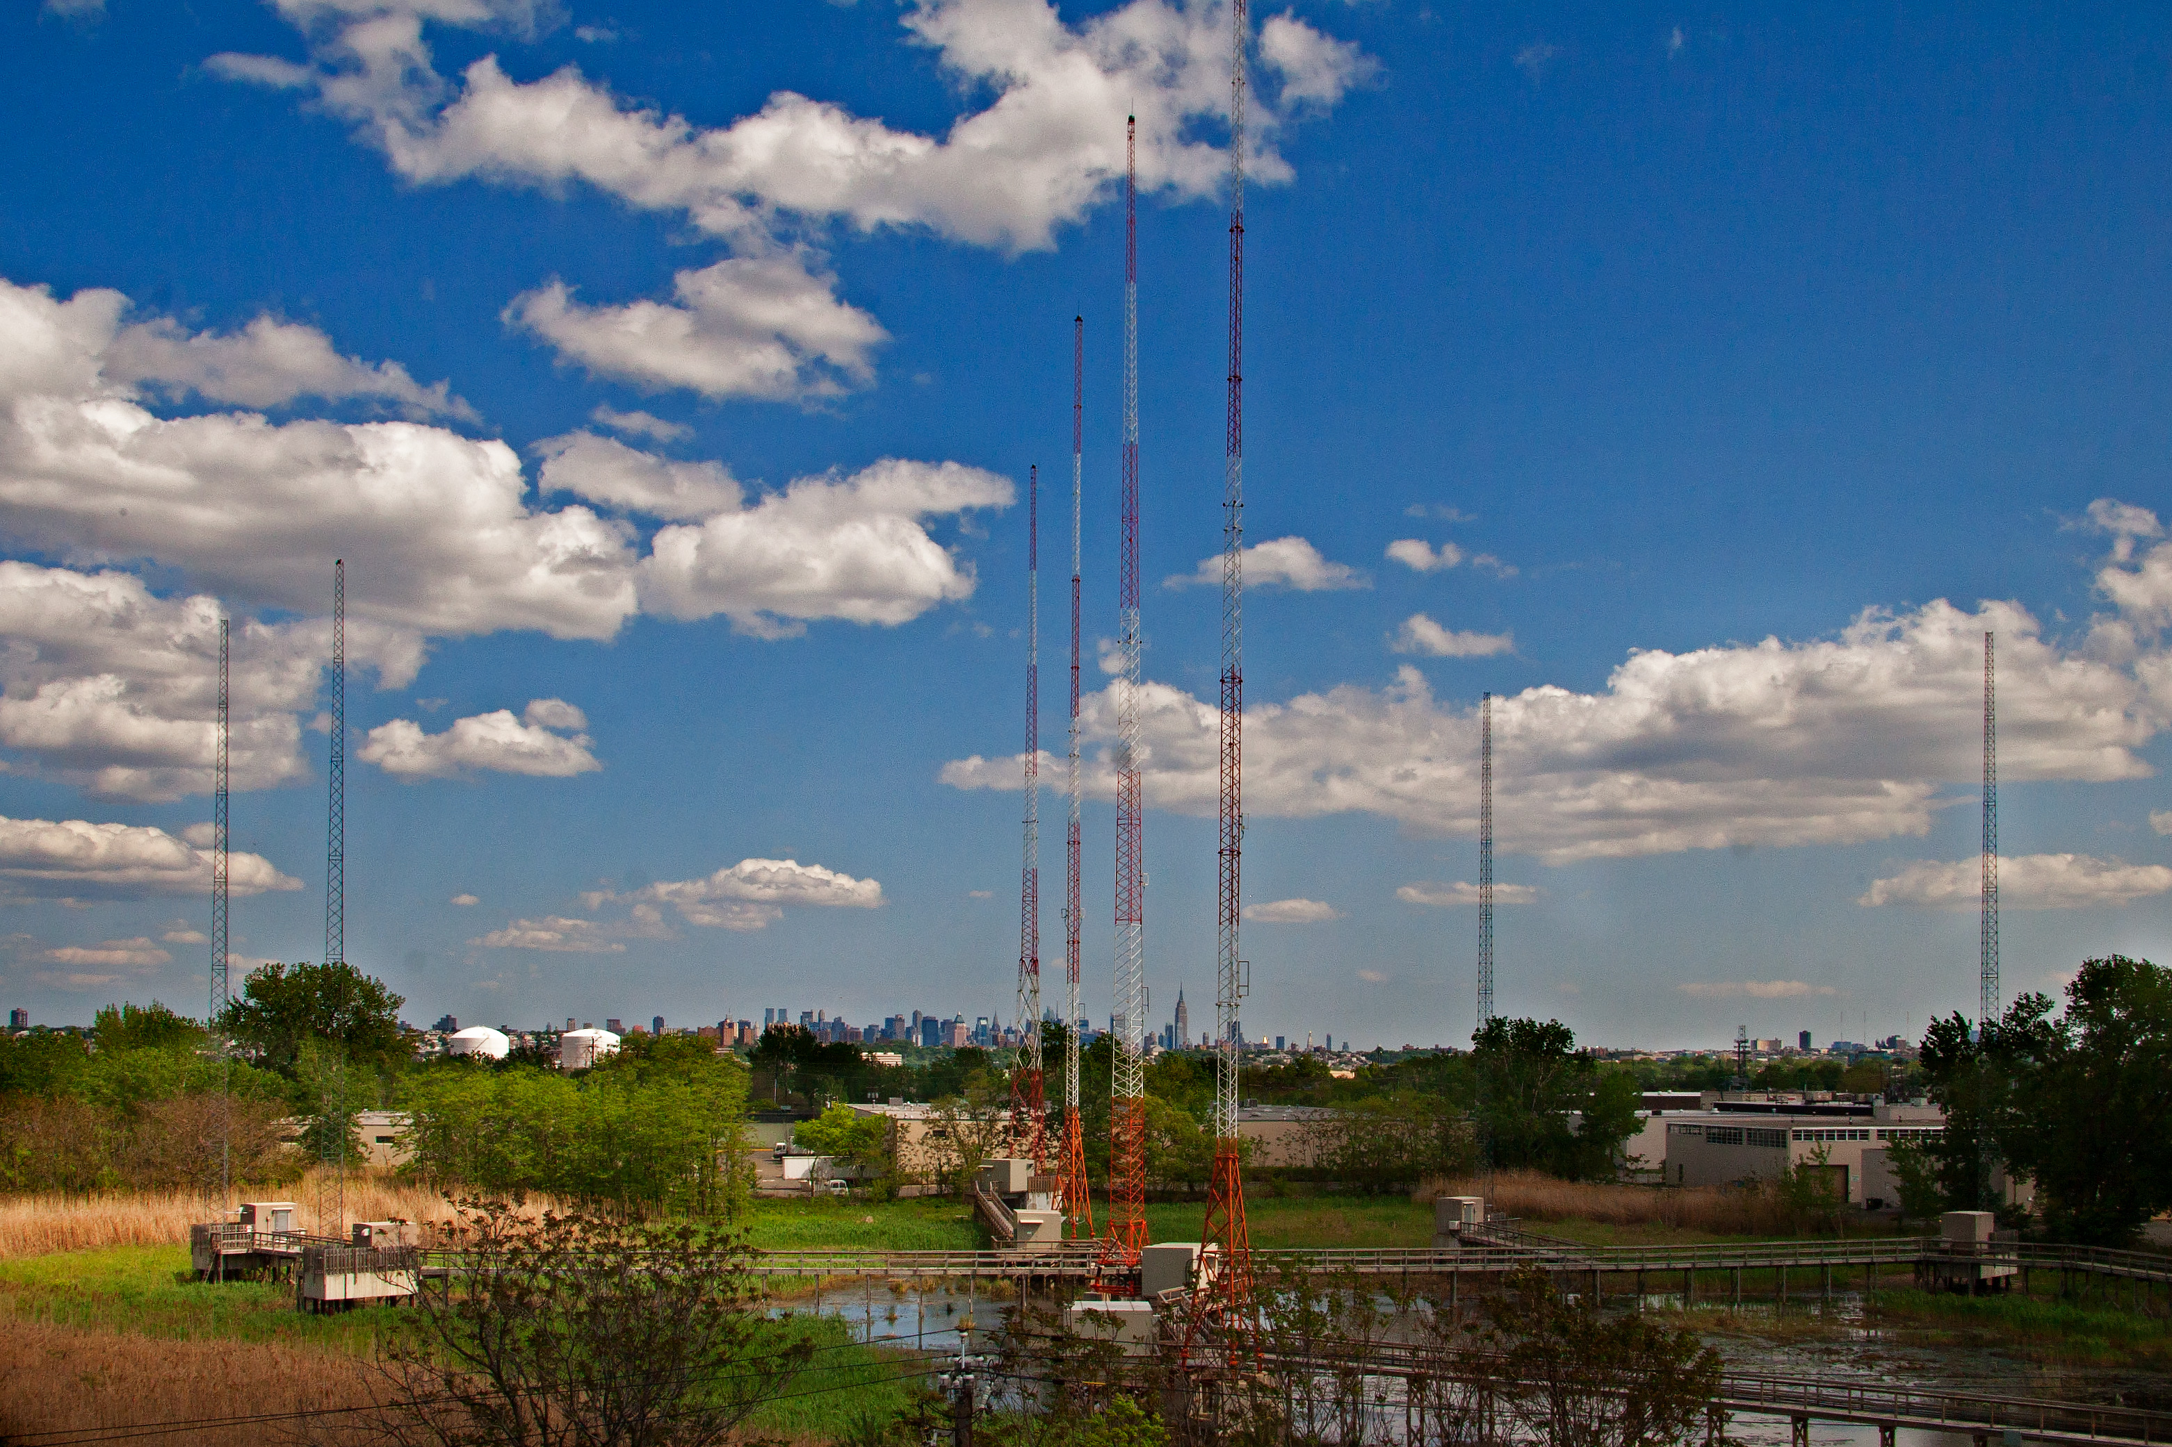
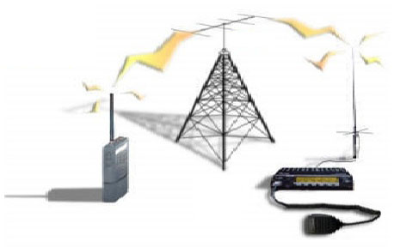
SOME CONSEQUENCES OF A RISING NOISE FLOOR
CELLPHONE DROPOUTS AM OR FM NOISY RADIO RECEPTION WIRELESS COMM DISRUPTION

Slide 4
QUESTIONS POSED IN THE TAC
TECHNICAL INQUIRY(TI)
Is there a noise problem
Where does the problem exist? Spectrally? Spatially? Temporally?
Is there quantitative evidence of the overall increase in the total integrated noise floor across various segments of the radio frequency spectrum?
How should a noise study be performed?

Slide 5
PURPOSE OF A TAC NOISE FLOOR STUDY
To develop a set of achievable and realizable goals to present to the Chairman of the FCC to act on in an effort to improve the reliability of broadcast and communications services that are being adversely affected by an increasing noise environment.
The noise floor study will be conducted in CY2017 with the goal of presenting recommendations to the FCC Chairman in Dec, 2017.

Slide 6
SOURCE OF
RESPONSES TO THE TAC TI*
There were a total of 93 responses:
  23 Companies/Industry Organizations
  39 RF Professionals(Broadcast and Wireless)
  31 Licensed radio amateurs
  *As reported by Geoff Mendenhall, consultant to GatesAir, who is currently serving on the TAC.

Slide 7
AMERICAN RADIO RELAY LEAGUE(ARRL)
RESPONSE HIGHLIGHTS
Man-made noise sources fall under one of the three categories:
  Intentional emitters, such as broadcast stations and wireless telecom cellphone networks
  Unintentional emitters, such as high efficiency fluorescent and LED lights, computer, plasma TV’s and switching power supplies(“wall warts”)
  Incidental emitters, such as overhead power lines and electric motors

Slide 8
ARRL RESPONSE HIGHLIGHTS (CONT.)
Broadcast and wireless comm operators should be aware of the FCC rule Part 15.5 that calls for operators of an interference-causing RF device to cease operating the device if interference to authorized services develops.
The IEEE Electromagnetic Compatibility Society Standards Development and Education Committee is developing an IEEE Recommended Practice on the resolution of power line noise complaints.

Slide 9
RECOMMENDATIONS OF THE SOCIETY OF BROADCAST ENGINEERS(SBE) TO THE TAC
Promote increased cooperation between manufacturers of Part 15 devices and users of radio spectrum to identify noise sources and take appropriate remedial action
Enact radiated emission limits below 30MHz in the FCC Part 15 rules for unintentional emitters
Reduce the Part 15 limits for LED lights to be harmonized with the Part 18 lower limits for fluorescent lights
Enact specific radiated and/or conducted emission limits for incidental emitters, such as motors or power lines

Slide 10
NATIONAL ASSOCIATION OF BROADCASTERS(NAB) TI RESPONSE HIGHLIGHT
THE FCC WAS CREATED TO ADDRESS THE INTERFERENCE CHAOS THAT THREATENED TO DESTROY NASCENT RADIO SERVICES IN THE EARLY 20TH CENTURY. THE FCC HAS UNFORTUNATELY RELINQUISHED THIS ROLE TO SELF-REGULATION OF THE MANUFACTURERS OF CONSUMER PRODUCTS WITH ASSOCIATED RF EMISSIONS, WHICH CLEARLY HAS LED TO DE-REGULATION OF THE NOISE FLOOR CONTRIBUTORS AND A RESULTING INCREASE IN THE NOISE FLOOR.

Slide 11
NAB RECOMMENDATIONS TO THE TAC
The FCC should review the general Part 15 emission limits to determine what improvements are necessary to protect licensed services and adopt strict and enforceable limits that will limit noise interference. As a minimum the Commission should adopt and enforce a radiated emissions limit of 0.025mV/m measured at a distance of 10m from the source to protect AM radio operators.
The FCC should re-examine Section 15.13 of its rules that states that manufacturers of incidental radiators should employ “good engineering practices to minimize the risk of harmful interference”.

Slide 12
NATIONAL PUBLIC SAFETY TELECOMMUNICATIONS COUNCIL(NPSTC) TI RESPONSE HIGHLIGHTS
Section 404.1 of the 2012 International Energy Conservation Code(IECC) requires that a minimum of 75% of lamps in permanently installed lighting fixtures should be high efficiency lamps. This started the widespread proliferation of compact fluorescent and LED lamps.
Industry Canada noise interference example: Electronic ballasts for fluorescent lights in a commercial store produced 20MHz wide broadband noise in the 800 MHz cellular band resulting in loss of coverage or dropped calls within 2km of the store location.

Slide 13
State of CA Governor’s Office of Emergency Services(CalOES) & Public Safety Communications TI Response Highlights
Major Sources of Noise Interference:
  Flourescent and LED lights
  Computers and imbedded controllers
  Switching power supplies and battery chargers
  Industrial equipment
  Power tools
  Solar panel inverters
  Cable TV/internet distribution systems
  Power line communications(PLC) & Broadband over Power Lines(BPL)
  Electric automobiles

Slide 14
CalOES TI HIGHLIGHTS(CONT.)
In response to the question “to what levels does the noise floor cause harmful interference to particular radio service”, CalOES responded:
  RECEIVER THRESHOLD LEVELS FOR SPECIFIED SERVICE BANDS
  BAND MINIMUM SIGNAL LEVEL*
  Low Band (40-50 MHz) -100 dBm
  VHF Band (150-170 MHz) -106 dBm
  UHF Band (450-470 MHz) -110 dBm
  700/800 MHz Band -116 dBm
  * Noise floor should be at least -10dBm below these levels.

Slide 15
CTIA: HOW DOES A RISING NOISE FLOOR IMPACT COMMERCIAL MOBILE RADIO SERVICE
Reduction in carrier’s reliable service area
Lost coverage for cell sites at the outer boundary of a carrier’s network
More dropped calls traveling between cell sites
Diminished voice quality
Slower data transmission or lost data packets

Slide 16
AT&T TI RESPONSE HIGHLIGHTS
AT&T in their efforts to work with industrial lighting manufacturers have found that they are motivated to disregard noise concerns due to the higher product cost of adding filter components.
AT&T is particularly concerned about the potential impact of noise on small cells sharing a support with LED lights. A single faulty power supply conducting noise through power lines can compromise their network service out to a distance of a half mile.
FM broadcast transmitter higher order harmonic content are the greatest noise source impacting AT&T mobility services. FM interference can degrade the uplink signal in the 700-2300 MHz band within 2,000 feet of the FM transmitting site.

Slide 17
AT&T RECOMMENDATIONS TO TAC
Mitigation of incidental radiator noise through updated industry standards, better testing protocols for device manufacturers and better clarity in FCC Part 15 and Part 18 rules
Improved testing up to 6 GHz to identify the potential for higher frequency noise to interfere with commercial mobile and public safety licensees
FCC should create incentives for FM broadcast transmission manufacturers to encourage the use of properly bonded and shielded metal cabinets
Minimize noise from data busses and interfaces in computer devices through enhanced and updated standards

Slide 18
SUMMARY AND CONCLUSIONS
Why do we need to regularly monitor and control the electromagnetic spectrum noise floor: In the event of natural disasters, war or terrorist activities secure, clear and reliable communications are absolutely critical
There was a clear consensus that a noise floor study is not only needed, but is way overdue
AM radio is the most significantly compromised broadcast service due to the rising noise floor
Operational service degradation experiences as were provided by numerous TI responders should be sufficient evidence to demonstrate the need for noise floor remediation
There was widespread agreement as to the identity of the major contributors to the rising noise floor.

Slide 19
SUMMARY AND CONCLUSIONS(CONT.)
We cannot afford to allow the producers of licensed and unlicensed products with associated RF emissions to be proliferated without increased regulatory action
The current FCC Part 15 and Part 18 rules need to be expanded to address the current noise floor spectrum
Understanding the noise floor versus frequency and what sources contribute to it is of great strategic importance to assure reliable and secure public communications for the safety of all US citizens
A suite of noise measurement equipment capable of monitoring noise in the DC to 70 GHz band with web access needs to be defined and implemented in urban, suburban and rural locations throughout the US to begin a comprehensive monitoring of the noise floor

